Slide 1
NopCommerce Project
Under the guidance of mrs. vaishali mam
- By ANKIREDDY MARY SWAPNA

Slide 2
INtroduction
Nopcommerce is a free and open-source e-commerce platform.
Link : https://demo.nopcommerce.com/
Used Page Object Model(POM), TESTNG, SELENIEUM, CUCUMBER FRAMEWORK FOR AUTOMATION.
Used Jira for project management .
Used Jenkins(Automation server) for CI/CD.

Slide 3
OVERVIEW :
WHAT IS NOPCOMMERCE ?
1. Nopcommerce is a free and open-source e-commerce platform.
2. It displays various categories like Computers, Apparel, Digital Downloads,
Gift Cards, etc.

Slide 4
RESPONSIBILITIES :
Creating test plans for modules
Creating test cases
Manual testing and automation
Identifying and creating defect report
Creating test cases analysis
Creating Epics, Story, Task and Bug in JIRA.

Slide 5
Modules :
MODULE 1 : Registration
Checked all the functionalities of registration page with all required and optional fields.
MODULE 2 : Login
Checked all the functionalities of Login page with valid and invalid scenarios.
MODULE 3 : Search
Checked all the functionalities to Validate user search product discovery flow .

Slide 6
MODULE 4 : Cart
Checked all the functionalities of shopping cart like add to cart and delete from cart.
MODULE 5 : Logout
Checked the functionality of Logout.
MODULE 6 : Wishlist
Checked whether the user is able to add a product to Wishlist.
MODULE 7 : Checkout
Validated the complete flow from product in cart to complete checkout .

Slide 7
MODULE 8 : Currency
Checked the functionality of changing currency .
MODULE 9 : Shop By Category
Checked whether the user is able to shop by category.
MODULE 10 : CompareList
Validated whether the user is able to add a product to compare list and view the added product in compare list.

Slide 8
Defects :
While testing, based on created test cases I have found some defects and created a defect report on those defects.

Slide 9
Defect identifier :- B_001
Defect summary :- Should display error showing password strength requirements not met
but accepting weak password .
Test Id :- DF_001
Test case name :- Reject_Weak_Password
Module name :- Register
Reproducible :- 1.Navigate to registration page
2.Fill firstname, lastname, email.
3.Fill password as 12345678
4.click on register button
Severity :- Low
Priority :- MEDIUM
Raised by :- SWAPNA
Assigned to :- Developer
Status :- pending

Slide 10
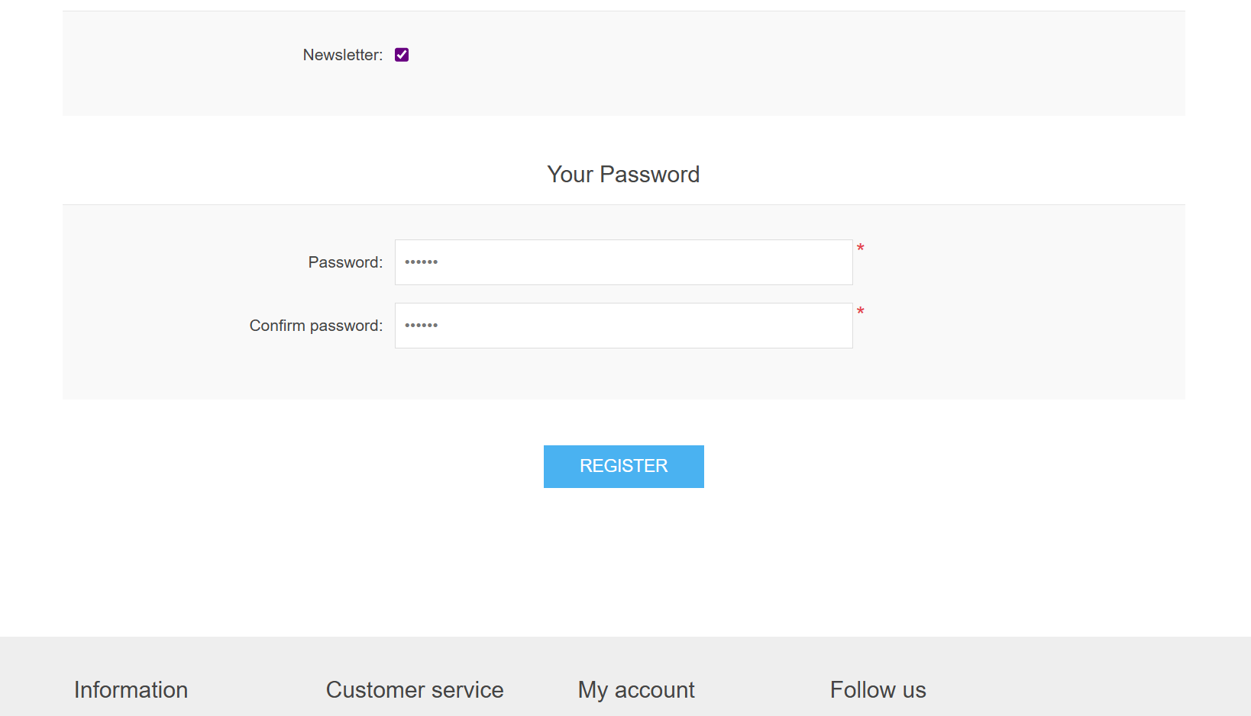

Slide 11
Defect identifier :- B_002
Defect summary :- Session persists on reopening the browser even after unchecking
"Remember me".
Test Id :- DF_002
Test case name :- Uncheck_RememberMe
Module name :- Login
Reproducible :- 1.Register
2.Navigate to login page
3.Enter credentials, uncheck "Remember me“ and login and navigate to any category
4. Close browser and open browser again.
Severity :- Medium
Priority :- Medium
Raised by :- SWAPNA
Assigned to :- Developer
Status :- pending

Slide 12
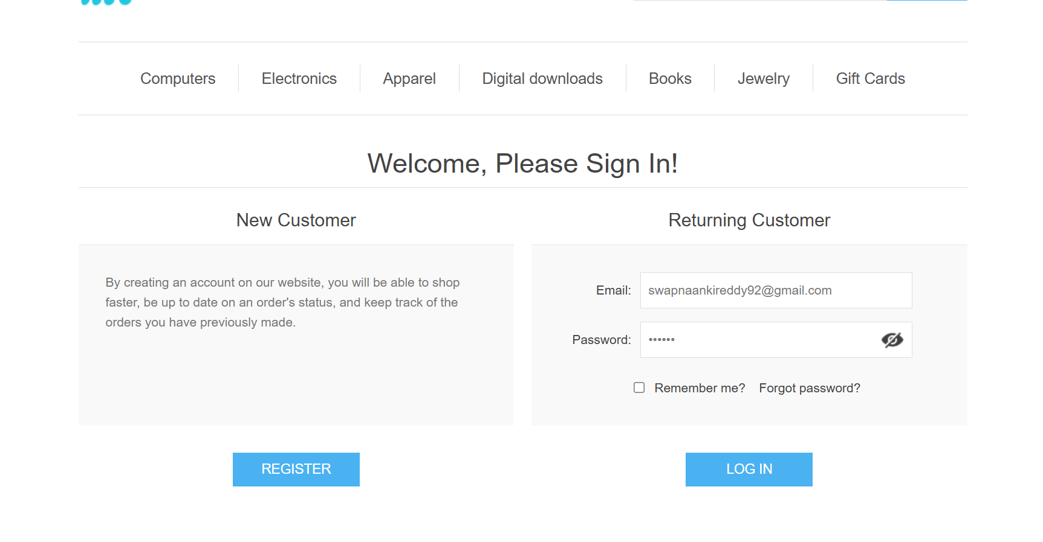
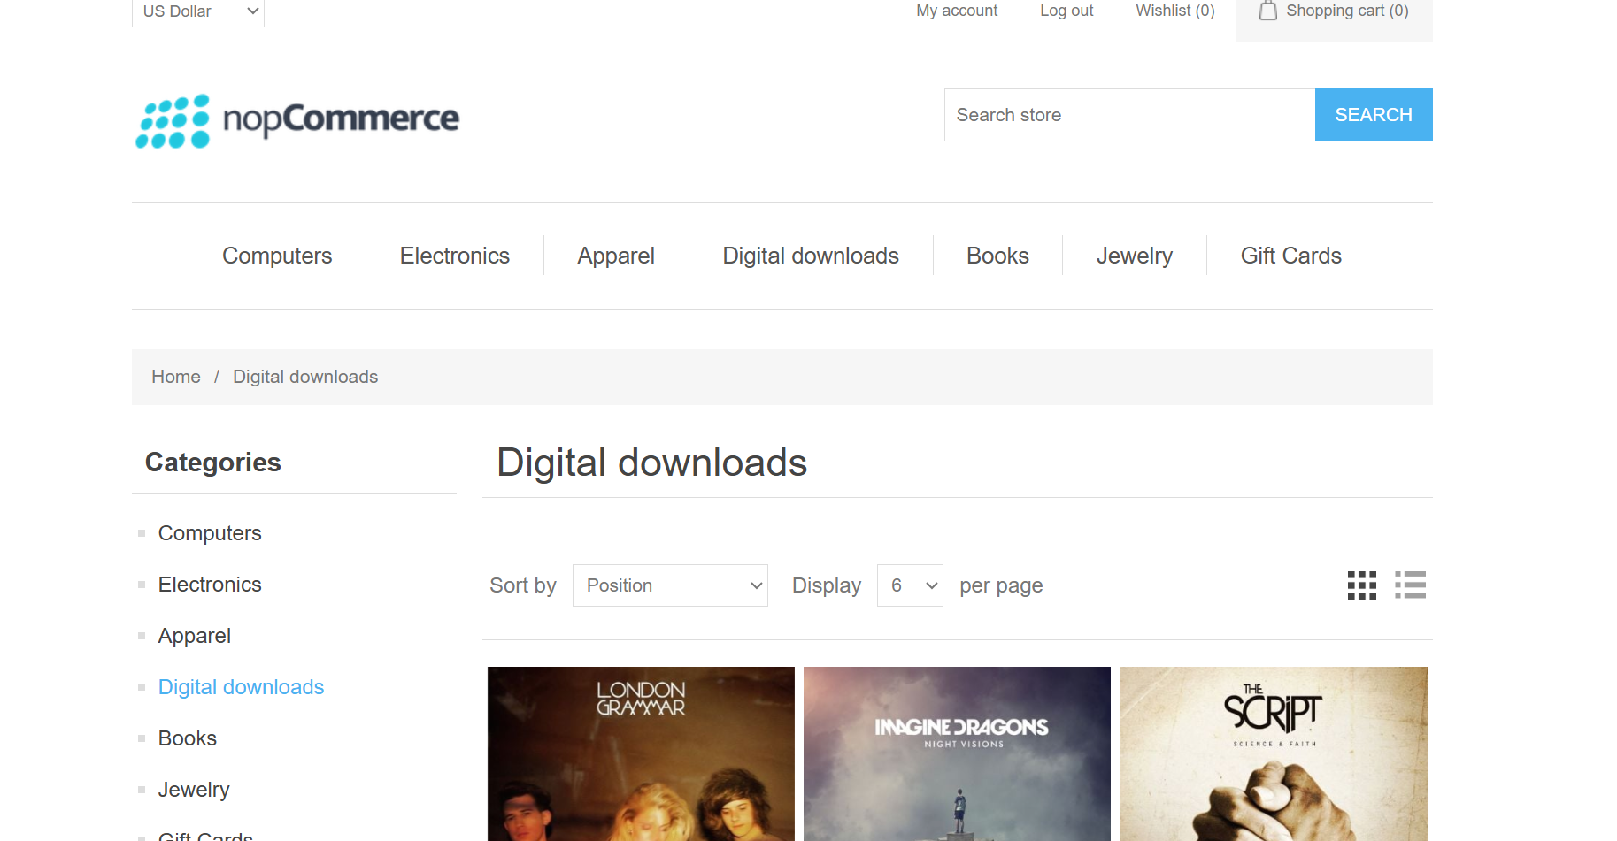

Slide 13
Defect identifier :- B_003
Defect summary :- didn't receive mail to reset password
Test Id :- DF_003
Test case name :- Forgot password flow
Module name :- Login
Reproducible :- 1. Open login page
2. Click "Forgot Password"
3. submit valid email and click reset password
4. Check provided mail inbox.
Severity :- High
Priority :- High
Raised by :- SWAPNA
Assigned to :- Developer
Status :- pending

Slide 14
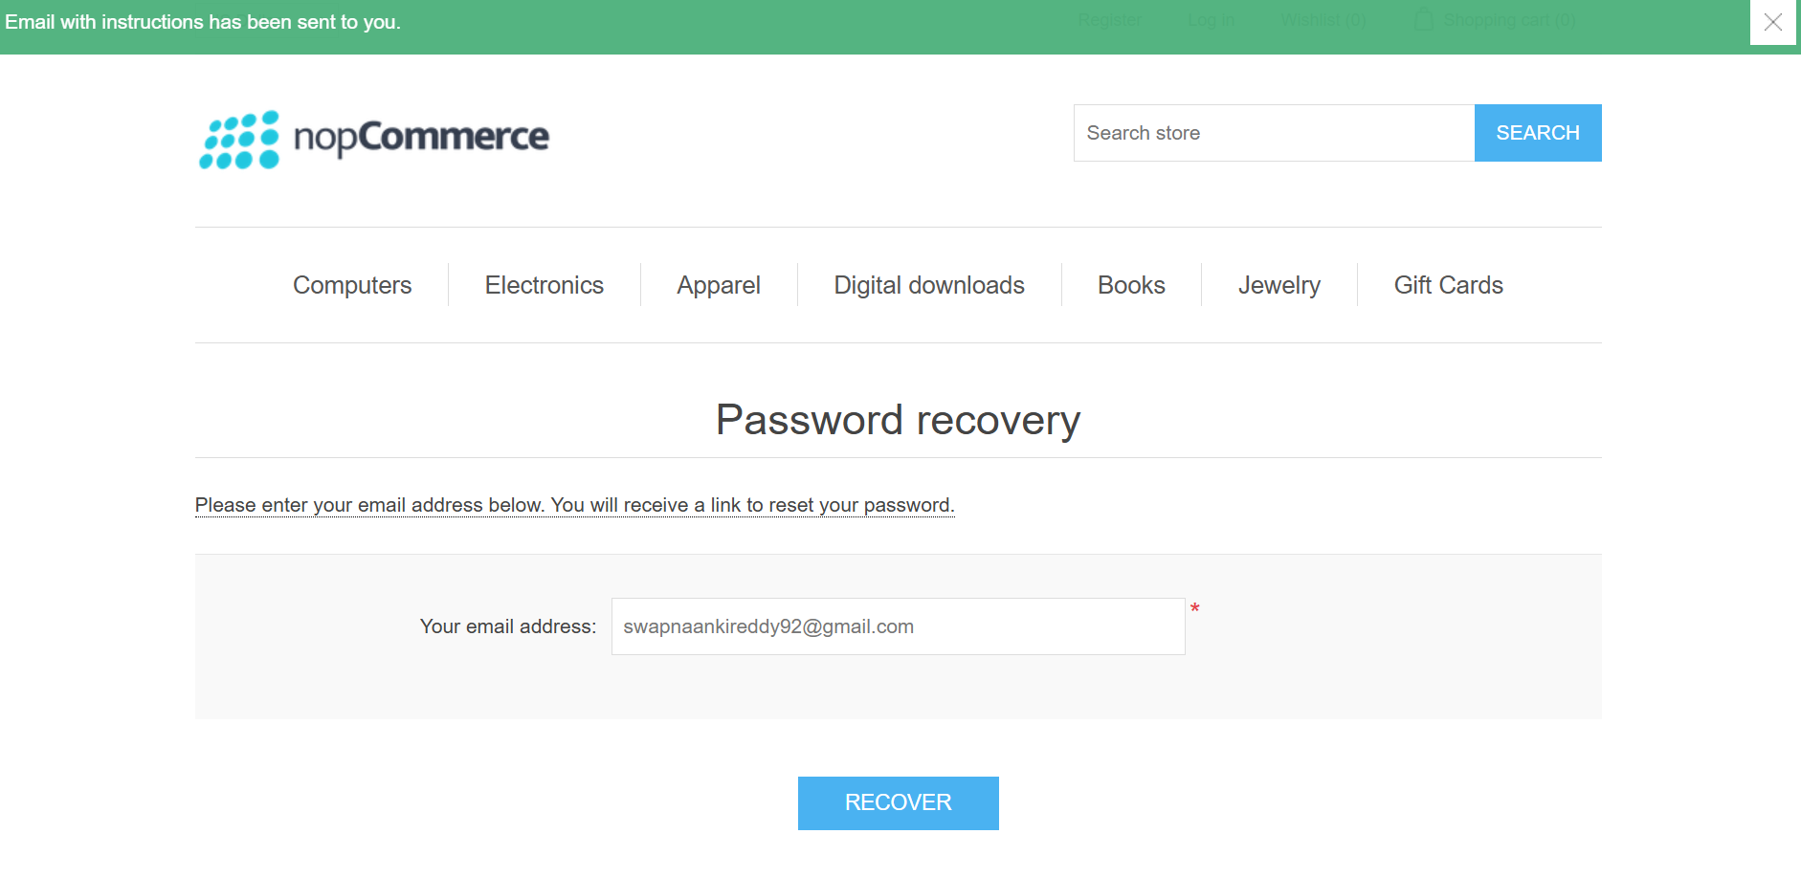

Slide 15
Defect identifier :- B_004
Defect summary :- Account not locked or not prevented from further login attempts (e.g., 10 times).
Test Id :- DF_004
Test case name :- Protection Against Brute Force
Module name :- Login
Reproducible :- 1. Attempt login with wrong password repeatedly (e.g., 10 times)
Severity :- Medium
Priority :- Medium
Raised by :- SWAPNA
Assigned to :- Developer
Status :- pending

Slide 16
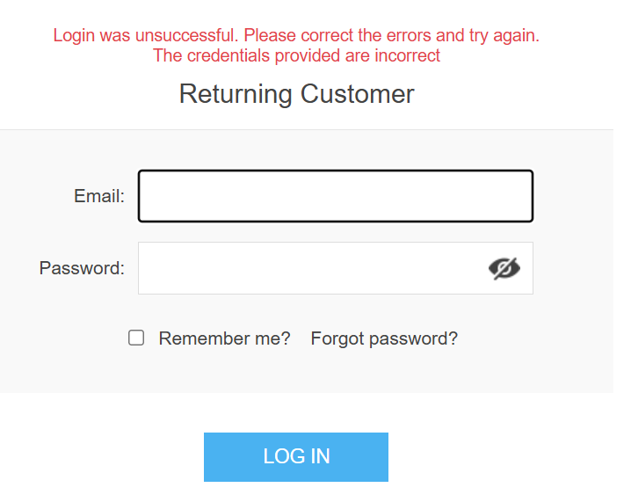

Slide 17
Challenges
While testing website we faced some challenges about:
It takes lots of time to perform manual testing on all modules in different browsers.
During automation it is finding locators and ensuring they doesn’t cause any exception is time taking.

Slide 18
Experience
Manual testing needs strong observation and in that testers needs to apply all possibilities in test cases.
Strong observation helped to find out bugs.
Gained experience to do efficient work by writing test cases, test plan, defect report, test case analysis and automating.
Good understanding of working with Jira(for project management) and Jenkins (for CI/CD).
Gained experience in writing Gherkin scenarios,Feature files,Step Definations.

Slide 19
Thank You!!!

